Slide 1
My Bohemian rhapsody
Another generation found in my maternal line

Slide 2
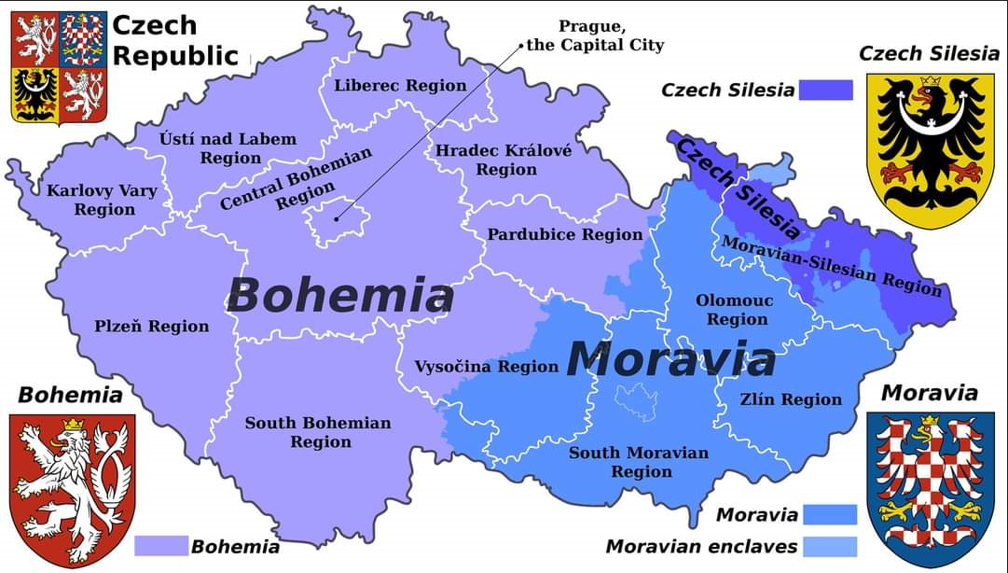
BOHEMIA

Slide 3
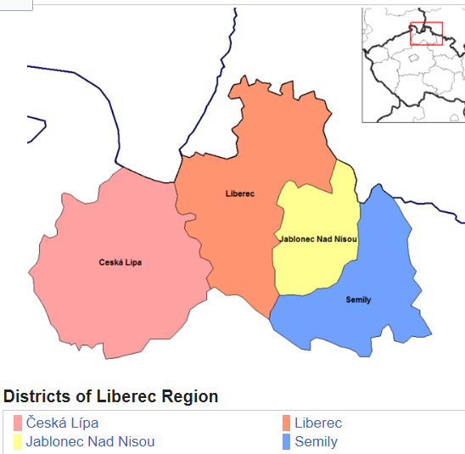
DISTRIcts of Liberec Region

Slide 4
MY MATERNAL LINE
Catharina Feix
B:
D:
Anna Theresia Svarowsky
B: 5 March 1769, Brand, Bohemia.
D:
Maria Anna Rößler
B: 9 September 1800, Schwarzbrunn, Bohemia.
D: 2 September 1881, Marschowitz, Gablonz, Bohemia.
Maria Anna Fleischmann
B:23 May 1834, Schwartzbrunn, Bohemia, Austria
D:5 December 1915 Buccleuch, South Australia.
Louise Elsa 'Elsie' Kuchel
B:15 December 1909, Murray Bridge, South Australia
D:12 October 1981, Murray Bridge, South Australia
Anna Maria Nicksch
B:19 February 1887, Bower, South Australia
D:18 July 1973, Victor Harbor, South Australia
Anna Wolf
B:15 January 1867,
Morchenstern, Bohemia.
D:8 October 1950, Murray Bridge, South Australia

Slide 5
SOURCe of bohemian data
http://vademecum.soalitomerice.cz

Slide 6
The LAST four generations

Slide 7
CONTACT Details
philip@philipmann.com.au
https://www.philipmann.com.au

