Slide 1
PURCHASE OF A NEW RESOURCE

Slide 2


Slide 3
What is a Familienbuch?
An Ortssippenbuch (town lineage book) or Ortsfamilienbuch (town family book) includes birth, marriage, and death data for all persons found in the local records during a specified time period, compiled into families. (Source: https://www.familysearch.org/en/wiki/Germany_Town_Genealogies_and_Parish_Register_Inventories_on_the_Internet)

Slide 4
HUGUENOTS
The Huguenots and Waldensians fled France after the Revocation of the Edict of Nantes in 1685 which forbade their Protestant faith.
They brought with them a wealth of craftsmanship, making it both economically and demographically beneficial for the Germans to welcome the French refugees.
It is estimated today that 250,000 Huguenots and Waldensians flew to neighbouring Protestant countries. Most of them were rich citizens with an important commercial or handcraft work. They went on foot through the Alps, using paths that were difficult but not controlled. The captured were thrown into prison or ended their lives on galleys. All captured priests were sentenced to death.

Slide 5
Schwabendorf https://www.ak-schwabendorf.de/schwabendorf_english.htm
Protestant lords offered religious freedom to the Huguenots, as well as land portions and exemption from taxes. The French-reformed community of Frankfurt supported 100,000 refugees between 1685 and 1705. A big number of them headed to Northern Hesse. Landgraf Carl of Hesse (1677-1730) opened his land to them with the "Hessische Freyheitsconzession" (Hessian Concession of Freedom).

Slide 6
MY PERSONAL INTEREST
However, the refugees also needed other professions, such as blacksmiths, carpenters, joiners etc.
That is why my 6xgreat grandfather Johann Jacob Kirchhainer probably settled in Schwabendorf as a blacksmith and innkeeper, becoming a "German" Frenchman in the process.
Likewise, later on, my 5xgreat grandfather, the stocking weaver Hartmann Hofmann, married into Schwabendorf.

Slide 7
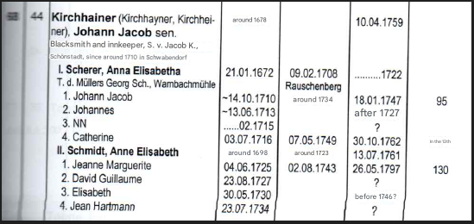
Example of an entry

Slide 8
Contact me
philip@philipmann.com.au

